Slide 1
Layered Architecture
By Gayatri Vastrad

Slide 2
What is Layered Architecture
What exactly are layers?
Layers in a Layered architecture are a collection of modules (classes in Java world, if you will) with common functionality.
In a layered architecture, layers are stacked on top of one of another:
Components from one layer are only allowed to communicate with the components from the layer one level below:

Slide 3
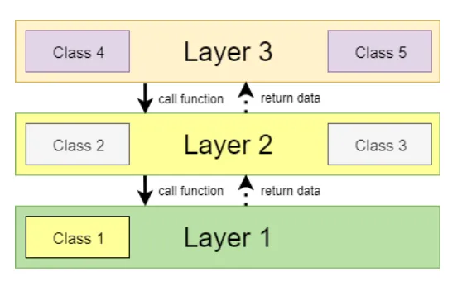
Layered Architecture

Slide 4
3-Layered Architecture
The most common type of Layered Architecture is a 3-Layered Architecture.
3-Layered Architecture consists of:
Presentation layer
Application layer
Data layer

Slide 5
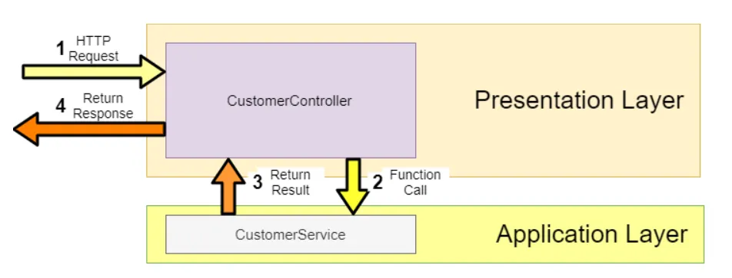
Presentation Layer
Presentation Layer is our connection to the outside world. This is where we handle all the incoming requests to our application and return a response.
This layer is also the first line of defense in our application because this is where we do authorization checks.
One layer below Presentation Layer is Application Layer.
Presentation Layer relies upon Application Layer to do all the functions the system should provide. Thus Presentation Layer has dependency only on the Application Layer.

Slide 6
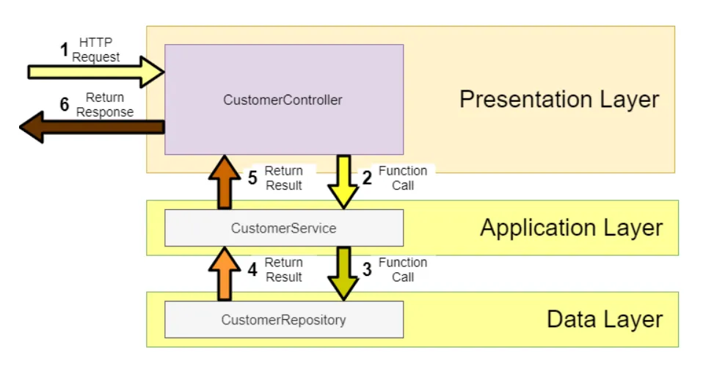
Application Layer
Application Layer is where we develop all the functions our application should provide.
So in terms of a Web Shop, this is where we implement functions for
addArticleToBasket, proceedToCheckout, cancelOrder ...
This is also where we do all our validations. For example, before adding an article to the customer's basket we can check that the customer has enough money to pay for the article.
Application Layer relies upon Data Layer to save all the data for later use or fetch some previously-saved data. Thus Application Layer has dependency only on Data Layer.

Slide 7
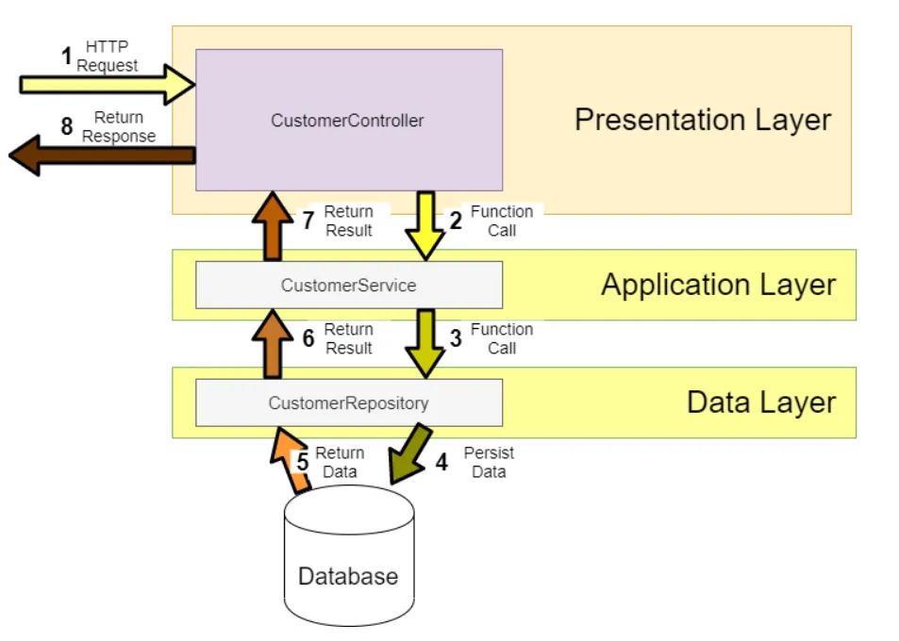
Data Layer
Data Layer handles the persisting of our data. It communicates with the Database and has no further dependencies.
Data Layer returns its data back to the Application Layer.

Slide 8
Pros and cons
What are the pros and cons of this type of architecture. Why did it become so popular and so widely used?
Pros:
Layers are isolated — changes to one layer don’t affect the other layers
Separation of concerns — each layer handles one aspect of our application and that makes our code more manageable
Layers can be independently tested
Defacto standard — it's well known by developers so everybody can easily find its way through the codebase
A quick way to get the application running without much complexity
Cons:
might be too much for simple CRUD — going through 3 layers only to create one database record
Layers all make a single application. Changes to one layer require redeployment of the whole app
Every Layer has a direct dependency on a layer below. This makes a tight coupling. It is not easy to swap out a layer with another one.

